Slide 1
ITO5201 - Machine Learning
Module 1: Elements of Machine Learning
Part B:
Probabilistic Machine Learning
basics of probability theory
probabilistic models and parameter estimation
quantifying uncertainty about arbitrary estimates (bootstrap)
Bayesian approach to ML
Notes:
1
We list the Bayesian approach here specially because of that, first this is a very important branch of machine learning and we will apply it to more complex problem in later modules, but here what we will do is just to give a introduction to its fundamental concepts.

Slide 2
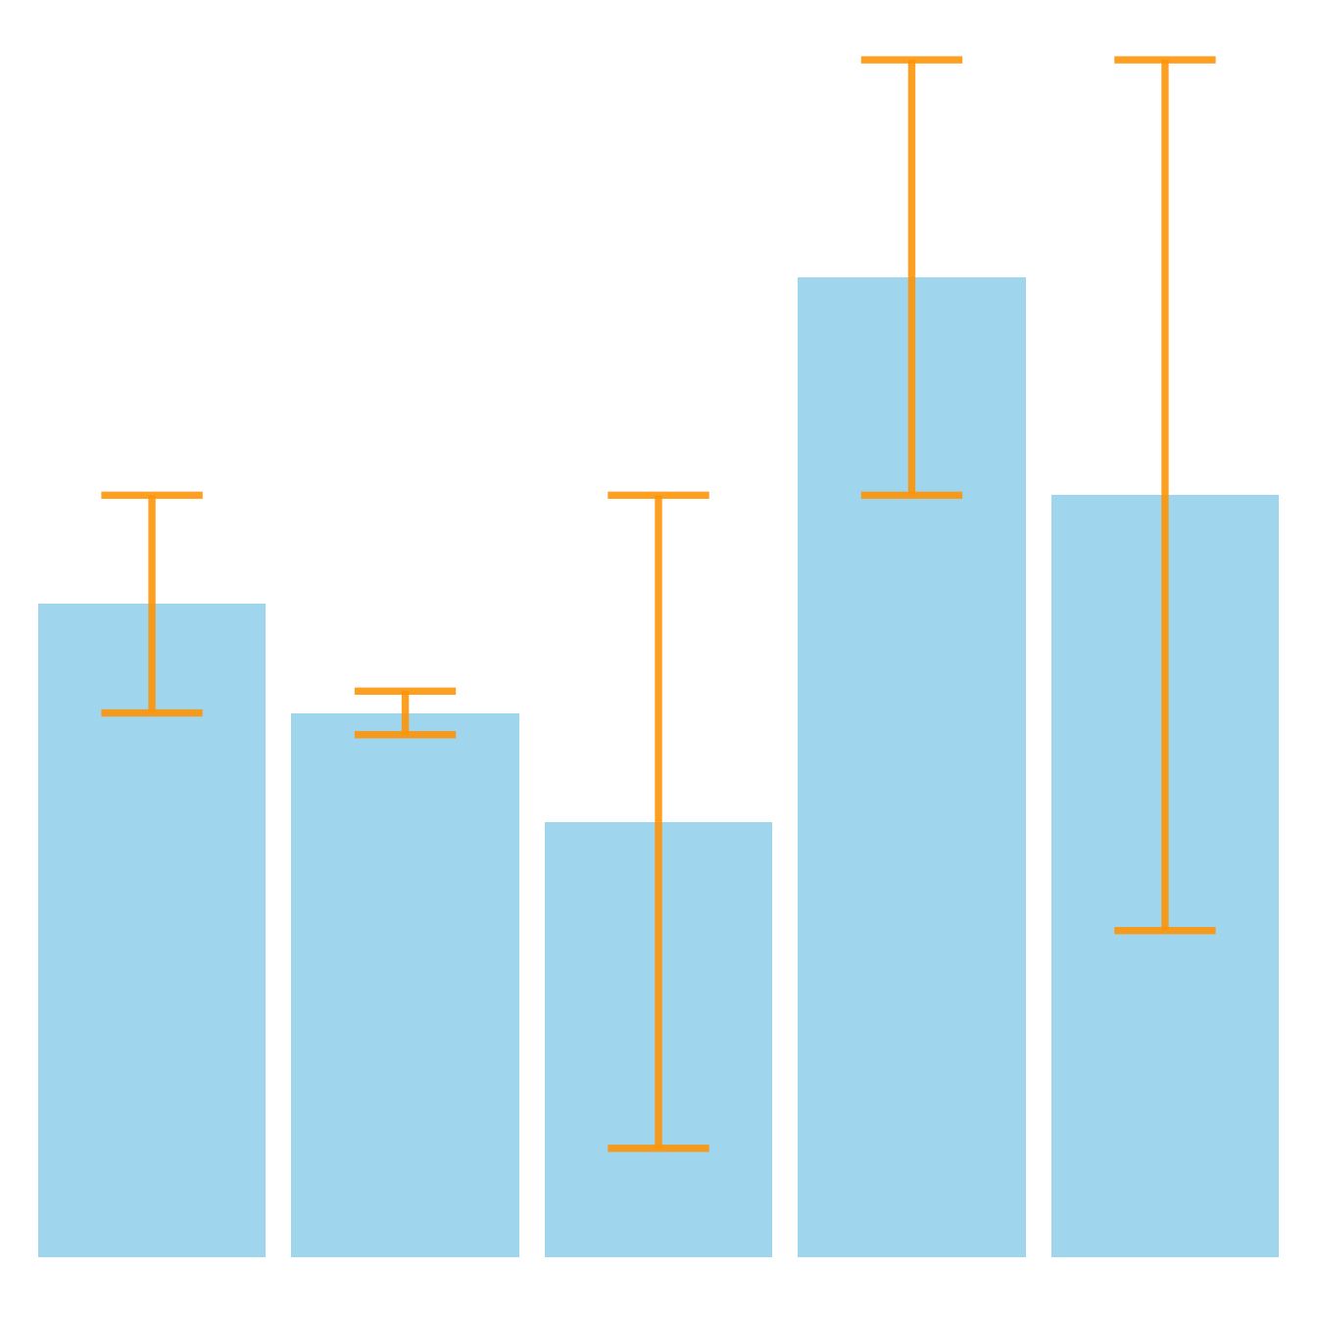
Uncertainty in Machine Learning (ML)
Intuition:
Cannot base decision on prediction without quantifying uncertainty
What is uncertainty and where does it come from?
Probabilistic Machine Learning
Notes:
Anybody has any idea about what uncertainty in machine learning means?
What is uncertainty? We are not sure how well the function we learn from the training set can perform on the future generalization task (or data unseen)
Uncertainty makes everything complicated. Because If the function fit to the training set well can definitely be used for future prediction on test set, then things are much easier, right? Because of uncertainty, ML is challenging. Without uncertainty, many fundamental concepts in ML will not exist. Like the regularization.
2

Slide 3
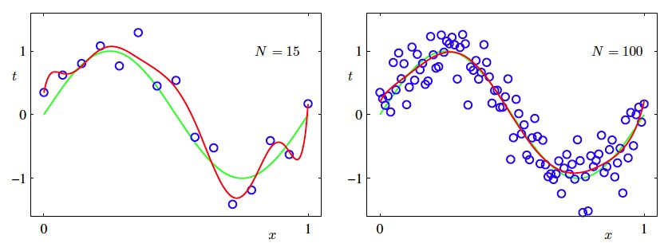
Uncertainty in Machine Learning (ML)
Non-determinism of modelled process (e.g., measurement noise): aleatoric uncertainty
Finite size of (random) training data / limited knowledge: epistemic uncertainty
Probabilistic Machine Learning
Notes:
The reasons? Noise and finite size of data sets. Both of them will change the shape of the real underlying function. Remember this experiment, for M=9, when the number of training data is only 10, the learned function fitting to the training error is like the graph in the previous slide, but if we increase the number of training data, the learned line, which is the red, getting more close to the green one. When
3

Slide 4
Probability Theory
Provides framework for defining and manipulating “uncertainty”
Used in ML to
Define learning task in a meaningful way (generalisation error, last week)
Enrich our concept of “model” from predictive to probabilistic
Quantify uncertainty about learned model parameters and predictions
Appendix A in Week 1 / Tutorial Resources / “Module one.pdf”
Probabilistic Machine Learning
Notes:
We will introduce how to use probability theory to capture our uncertainty from two different views, one is frequentist and another one is Bayesian statistics. They capture the uncertainty in different ways. But both of them are using the knowledge from probability theory.
4

Slide 5


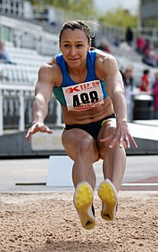
Basics of Probability Theory
Mathematical model of (repeatable) random experiments like:
flipping a coin
rolling two dice
athlete performing
long jump
Probabilistic Machine Learning
Notes:
There are many fundamental concepts in probability theory. Like random variables, the probability distributions. To illustrate these fundamental concepts, I will walk you through a coin tossing example.
Assume we are tossing a coin, the event we try to model is the outcome of tossing a coin, which is landing head or tail. We all know that one important part in probability theory is to provide mathematical abstractions of non-deterministic or uncertain process. So, let’s start with a mathematical modeling of the coin tossing event.
5

Slide 6
Random Variables
Random variables ”measure” specific aspects of experiment outcome like:
side in which coin lands
sum of eyes rolled
distance jumped
Probabilistic Machine Learning
Notes:
There are many fundamental concepts in probability theory. Like random variables, the probability distributions. To illustrate these fundamental concepts, I will walk you through a coin tossing example.
Assume we are tossing a coin, the event we try to model is the outcome of tossing a coin, which is landing head or tail. We all know that one important part in probability theory is to provide mathematical abstractions of non-deterministic or uncertain process. So, let’s start with a mathematical modeling of the coin tossing event.
6

Slide 7



Random Variables
Domain of random variable is associated set of possible values
$$\{H(ead), T(ail)\}$$
$$\{1,…,12\}$$
$$ℝ_{+}$$
Probabilistic Machine Learning
Notes:
There are many fundamental concepts in probability theory. Like random variables, the probability distributions. To illustrate these fundamental concepts, I will walk you through a coin tossing example.
Assume we are tossing a coin, the event we try to model is the outcome of tossing a coin, which is landing head or tail. We all know that one important part in probability theory is to provide mathematical abstractions of non-deterministic or uncertain process. So, let’s start with a mathematical modeling of the coin tossing event.
7

Slide 8
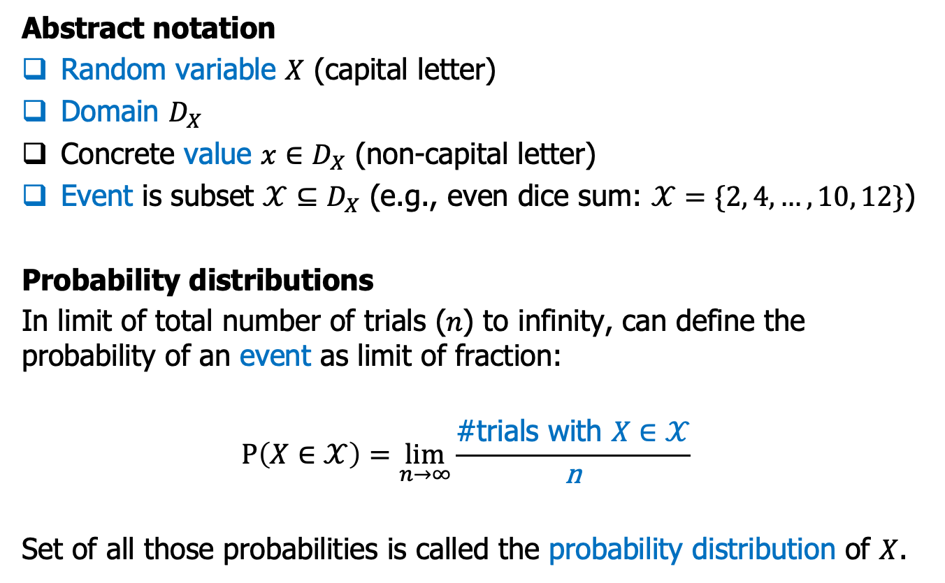
Distributions
Abstract notation
Random variable $X$ (capital letter)
Domain $D_{X}$
Concrete value ${x∈D}_{X}$ (non-capital letter)
Event is subset $𝒳⊆D_{X}$ (e.g., even dice sum: $𝒳=\{2, 4, …,10, 12\}$)
Probability distributions
In limit of total number of trials (𝑛) to infinity, can define the probability of an event as limit of fraction:
$$P\left(X∈𝒳\right)=\lim_{n→∞}⁡\frac{\text{\#}\text{trials} \text{with} X∈𝒳}{\text{n}}$$
Set of all those probabilities is called the probability distribution of $X$.

Slide 9

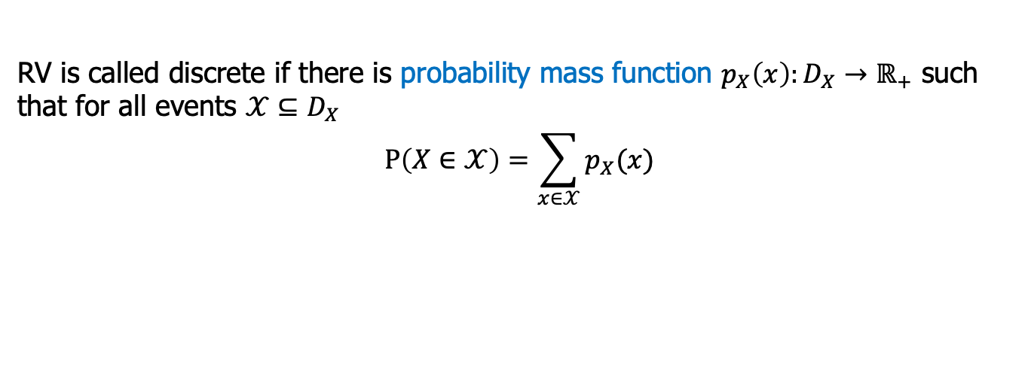

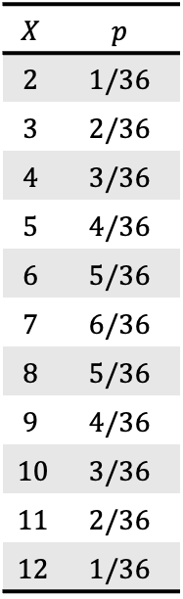
Discrete Random Variables
RV is called discrete if there is probability mass function $p_{X}\left(x\right):D_{X}→ℝ_{+}$ such that for all events $𝒳⊆D_{X}$
$$P\left(X∈𝒳\right)=\sum_{x∈𝒳}{p_{X}(x)}$$
Example: sum of two dice
$$X$$ | $$p$$
$$2$$ | $$1/36$$
$$3$$ | $$2/36$$
$$4$$ | $$3/36$$
$$5$$ | $$4/36$$
$$6$$ | $$5/36$$
$$7$$ | $$6/36$$
$$8$$ | $$5/36$$
$$9$$ | $$4/36$$
$$10$$ | $$3/36$$
$$11$$ | $$2/36$$
$$12$$ | $$1/36$$
$$P\left(X∈\{2,4,…,12\}\right)=p_{X}\left(2\right)+p_{X}\left(4\right)+…+p_{X}(12)$$
$$=\frac{1}{36}+\frac{3}{36}+\frac{5}{36}+\frac{5}{36}+\frac{3}{36}+\frac{1}{36}$$
$$=\frac{18}{36}=\frac{1}{2}$$
Probabilistic Machine Learning
Notes:
Distinguish between probability distribution and the empirical distribution from data we observe. Probability distribution is something determined by nature of the process. For coin tossing, it is determined maybe by the materials of the coin and distribution of materials of the coin, the gesture of your hand when you toss the coin. Empirical distribution is the probability distribution given one trial. For example, you try 10 times with 3 times being head……empirical distribution is just one sample from the probability distribution. Some students might be wondering, usually, what we have is data, is empirical distribution, is it possible to approximate it with empirical distribution, here is the formal answer, in the limit that number of trials goes to infinity, you can say that they are equal. For example, if you go toss the coin infinite times, then we can calculate…….this actually link us to one ML challenge we mentioned before, the finite dataset size……..
9

Slide 10
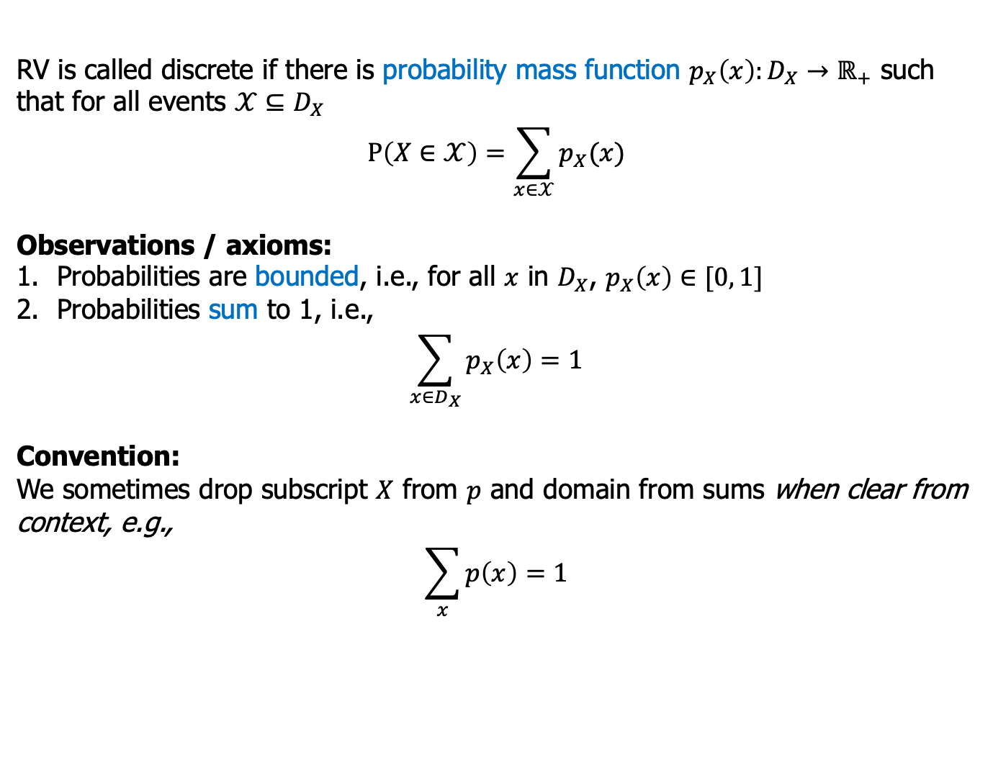
Discrete Random Variables
RV is called discrete if there is probability mass function $p_{X}\left(x\right):D_{X}→ℝ_{+}$ such that for all events $𝒳⊆D_{X}$
$$P\left(X∈𝒳\right)=\sum_{x∈𝒳}{p_{X}(x)}$$
Observations / axioms:
Probabilities are bounded, i.e., for all $x$ in $D_{X}$, $p_{X}\left(x\right)∈[0, 1]$
Probabilities sum to 1, i.e.,
$$\sum_{x∈D_{X}}{p_{X}\left(x\right)=1}$$
Convention:
We sometimes drop subscript $X$ from $p$ and domain from sums when clear from context, e.g.,
$$\sum_{x}{p\left(x\right)=1}$$
Probabilistic Machine Learning
Notes:
Distinguish between probability distribution and the empirical distribution from data we observe. Probability distribution is something determined by nature of the process. For coin tossing, it is determined maybe by the materials of the coin and distribution of materials of the coin, the gesture of your hand when you toss the coin. Empirical distribution is the probability distribution given one trial. For example, you try 10 times with 3 times being head……empirical distribution is just one sample from the probability distribution. Some students might be wondering, usually, what we have is data, is empirical distribution, is it possible to approximate it with empirical distribution, here is the formal answer, in the limit that number of trials goes to infinity, you can say that they are equal. For example, if you go toss the coin infinite times, then we can calculate…….this actually link us to one ML challenge we mentioned before, the finite dataset size……..
10

Slide 11
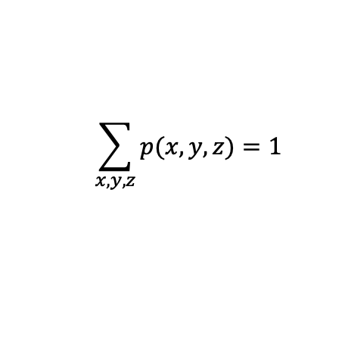

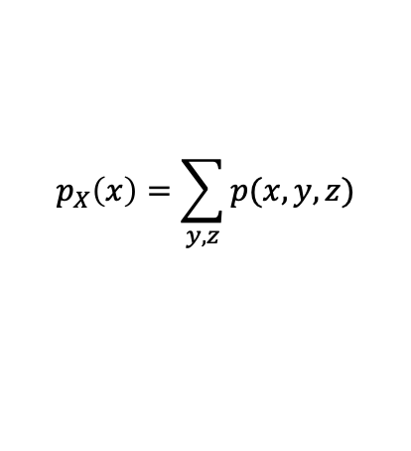
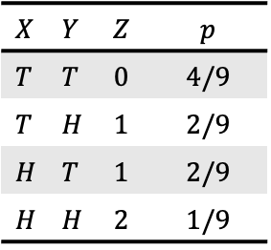
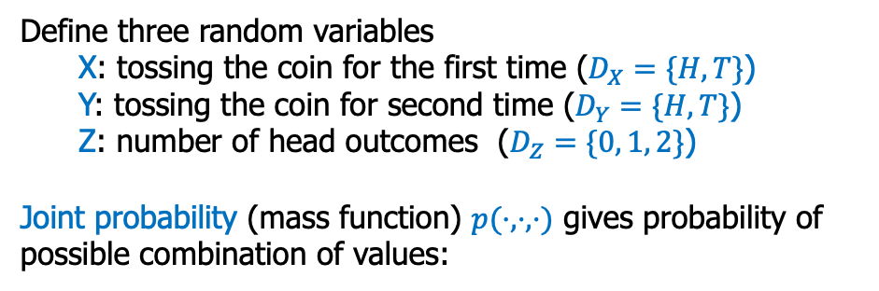
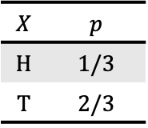
Two or More Variables: Joint and Marginal Probabilities
Random Variables:
X, Y, Z
Define three random variables
X: tossing the coin for the first time ($D_{X}=\{H,T\}$)
Y: tossing the coin for second time ($D_{Y}=\{H,T\}$)
Z: number of head outcomes ($D_{Z}=\{0, 1, 2\}$)
Joint probability (mass function) $p(⋅, ⋅,⋅)$ gives probability of possible combination of values:
$$X$$ | $$Y$$ | $$Z$$ | $$p$$
$$T$$ | $$T$$ | $$0$$ | $$4/9$$
$$T$$ | $$H$$ | $$1$$ | $$2/9$$
$$H$$ | $$T$$ | $$1$$ | $$2/9$$
$$H$$ | $$H$$ | $$2$$ | $$1/9$$
$$X$$ | $$p$$
$$H$$ | $$1/3$$
$$T$$ | $$2/3$$
marginal probability
$$p_{X}\left(x\right)=\sum_{y,z}{p(x,y,z)}$$
(omitted entries w. $p=0$)
$$\sum_{x,y,z}{p(x,y,z)}=1$$
Again, all probabilities sum to 1:
Probabilistic Machine Learning
Example 2: Tossing two coins
Notes:
11

Slide 12
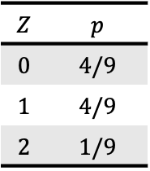
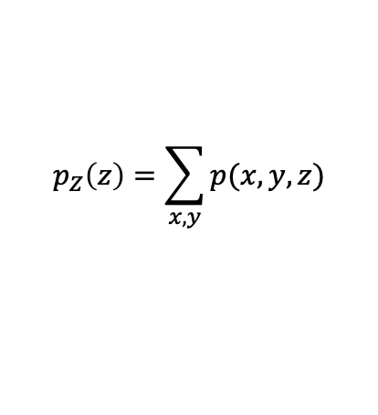
Two or More Variables: Joint and Marginal Probabilities
Random Variables:
X, Y, Z
Define three random variables
X: tossing the coin for the first time ($D_{X}=\{H,T\}$)
Y: tossing the coin for second time ($D_{Y}=\{H,T\}$)
Z: number of head outcomes ($D_{Z}=\{0, 1, 2\}$)
Joint probability (mass function) $p(⋅, ⋅,⋅)$ gives probability of possible combination of values:
$$X$$ | $$Y$$ | $$Z$$ | $$p$$
$$T$$ | $$T$$ | $$0$$ | $$4/9$$
$$T$$ | $$H$$ | $$1$$ | $$2/9$$
$$H$$ | $$T$$ | $$1$$ | $$2/9$$
$$H$$ | $$H$$ | $$2$$ | $$1/9$$
$$Z$$ | $$p$$
$$0$$ | $$4/9$$
$$1$$ | $$4/9$$
$$2$$ | $$1/9$$
marginal probability
$$p_{Z}\left(z\right)=\sum_{x,y}{p(x,y,z)}$$
(omitted entries w. $p=0$)
$$\sum_{x,y,z}{p(x,y,z)}=1$$
Again, all probabilities sum to 1:
Probabilistic Machine Learning
Example 2: Tossing two coins
Notes:
12

Slide 13
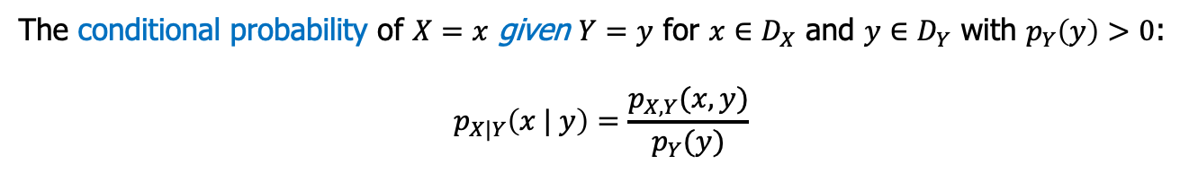
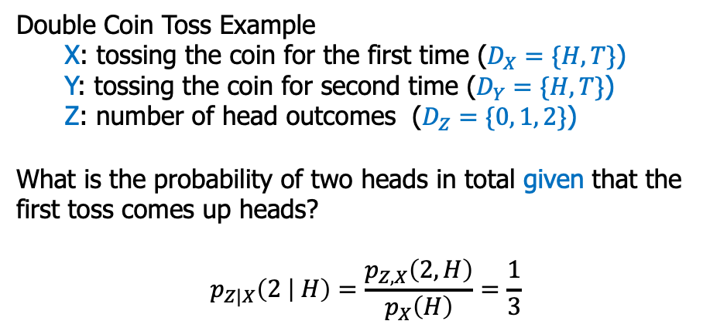
Conditional Probability
The conditional probability of $X=x$ given $Y=y$ for $x∈D_{X}$ and $y∈D_{Y}$ with $p_{Y}\left(y\right)>0$:
$$p_{X|Y}\left(x | y\right)=\frac{p_{X,Y}(x,y)}{p_{Y}(y)}$$
Double Coin Toss Example
X: tossing the coin for the first time ($D_{X}=\{H,T\}$)
Y: tossing the coin for second time ($D_{Y}=\{H,T\}$)
Z: number of head outcomes ($D_{Z}=\{0, 1, 2\}$)
What is the probability of two heads in total given that the first toss comes up heads?
$$p_{Z|X}\left(2 | H\right)=\frac{p_{Z,X}\left(2, H\right)}{p_{X}\left(H\right)}=\frac{1}{3}$$
Probabilistic Machine Learning
Notes:
13

Slide 14
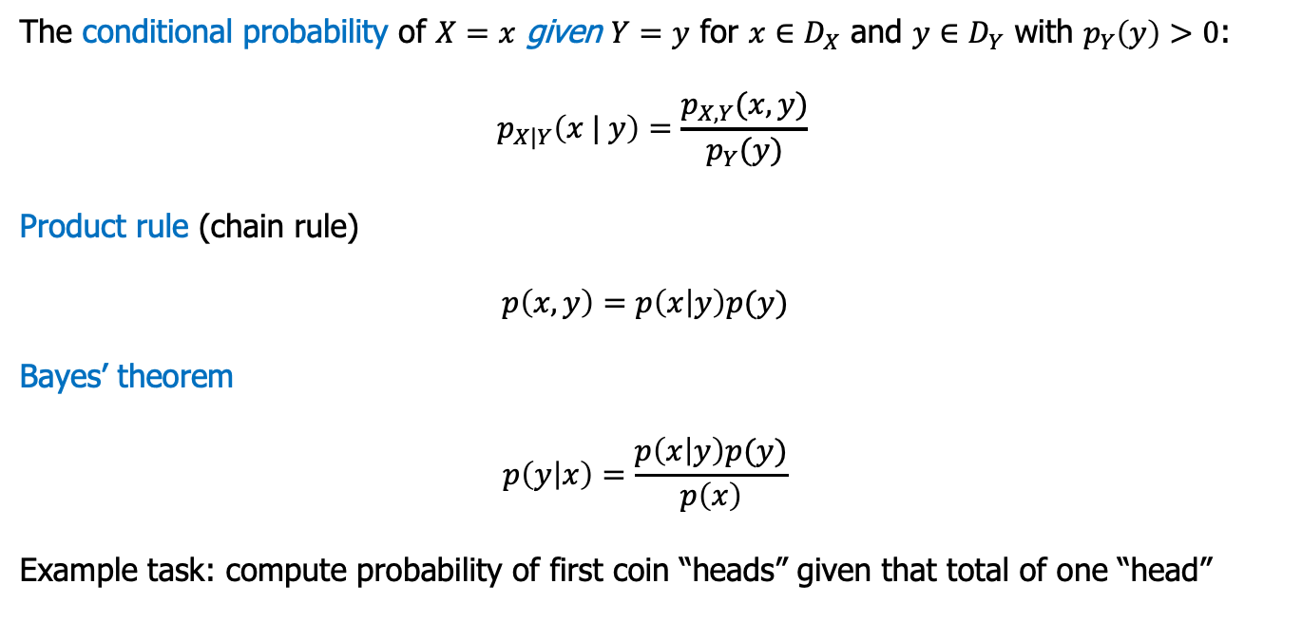
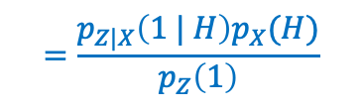

Conditional Probability
The conditional probability of $X=x$ given $Y=y$ for $x∈D_{X}$ and $y∈D_{Y}$ with $p_{Y}\left(y\right)>0$:
$$p_{X|Y}\left(x | y\right)=\frac{p_{X,Y}(x,y)}{p_{Y}(y)}$$
Product rule (chain rule)
$$p\left(x,y\right)=p\left(x | y\right)p(y)$$
Bayes’ theorem
$$p\left(y | x\right)=\frac{p\left(x | y\right)p(y)}{p\left(x\right)}$$
Example task: compute probability of first coin “heads” given that total of one “head”
$$=\frac{\frac{2}{3}⋅\frac{1}{3}}{\frac{4}{9}}=\frac{1}{2}$$
$$=\frac{p_{Z|X}\left(1 | H\right)p_{X}(H)}{p_{Z}\left(1\right)}$$
$$p_{X|Z}\left(H | 1\right)$$
Probabilistic Machine Learning
Notes:
14

Slide 15
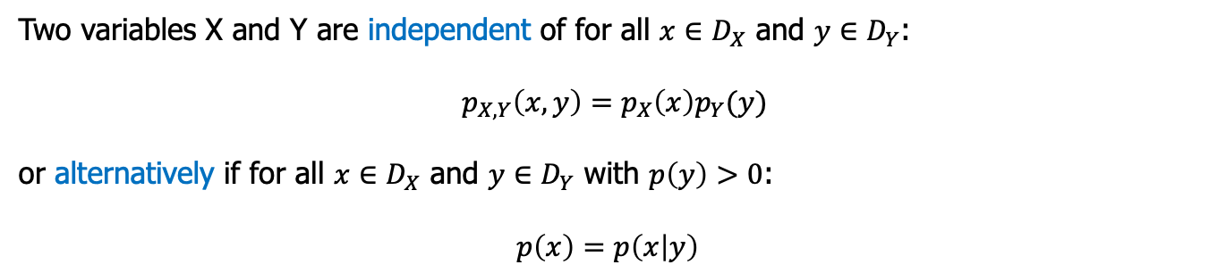
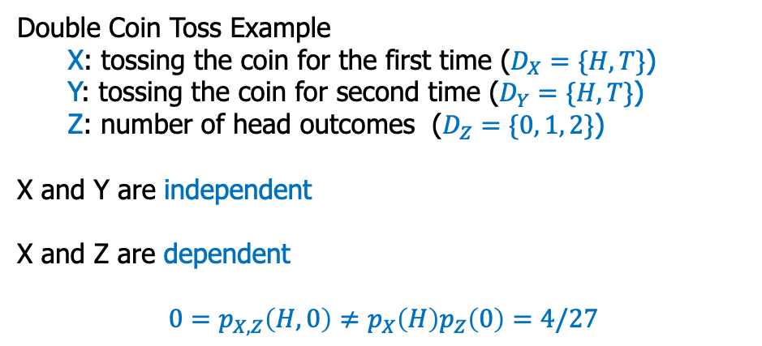
Two Variables: Independence
Two variables X and Y are independent of for all $x∈D_{X}$ and $y∈D_{Y}$:
$$p_{X,Y}\left(x,y\right)=p_{X}\left(x\right)p_{Y}(y)$$
or alternatively if for all $x∈D_{X}$ and $y∈D_{Y}$ with $p\left(y\right)>0$:
$$p\left(x\right)=p\left(x | y\right)$$
Double Coin Toss Example
X: tossing the coin for the first time ($D_{X}=\{H,T\}$)
Y: tossing the coin for second time ($D_{Y}=\{H,T\}$)
Z: number of head outcomes ($D_{Z}=\{0, 1, 2\}$)
X and Y are independent
X and Z are dependent
$$0=p_{X,Z}\left(H,0\right)≠p_{X}\left(H\right)p_{Z}\left(0\right)=4/27$$
Probabilistic Machine Learning
Notes:
15

Slide 16


Continuous Random Variables
Continuous random variables $X$ with domain $D_{X}⊆ℝ$ and $P(X=x)=0$
Distribution given by probability density function (pdf) $p\left(x\right)≥0$ that describes probability of event $a≤X≤b$ by integration
$$P\left(a≤X≤b\right)=\int_{a}^{b}{p\left(x\right)dx}$$
Example: time until you receive first email on random workday
$$p\left(x\right)=\frac{3}{2}\exp\left(−\frac{3}{2}x\right)$$
Probabilistic Machine Learning
Notes:
16

Slide 17

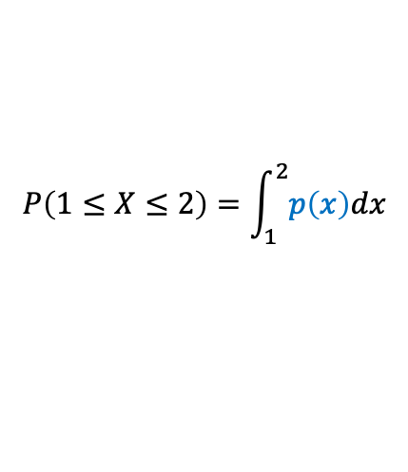

Continuous Random Variables
Continuous random variables $X$ with domain $D_{X}⊆ℝ$ and $P(X=x)=0$
Distribution given by probability density function (pdf) $p\left(x\right)≥0$ that describes probability of event $a≤X≤b$ by integration
$$P\left(a≤X≤b\right)=\int_{a}^{b}{p\left(x\right)dx}$$
Example: time until you receive first email on random workday
$$p\left(x\right)=\frac{3}{2}\exp\left(−\frac{3}{2}x\right)$$
Question: probability of receiving first mail in second hour of work?
$$P\left(1≤X≤2\right)=\int_{1}^{2}{p\left(x\right)dx}$$
$$=0.173343…$$
Probabilistic Machine Learning
Notes:
17

Slide 18
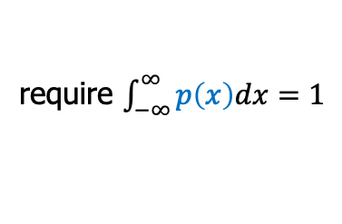
Continuous Random Variables
Continuous random variables $X$ with domain $D_{X}⊆ℝ$ and $P(X=x)=0$
Distribution given by probability density function (pdf) $p\left(x\right)≥0$ that describes probability of event $a≤X≤b$ by integration
$$P\left(a≤X≤b\right)=\int_{a}^{b}{p\left(x\right)dx}$$
Example: time until you receive first email on random workday
$$p\left(x\right)=\frac{3}{2}\exp\left(−\frac{3}{2}x\right)$$
require $\int_{−∞}^{∞}{p\left(x\right)dx}=1$
Probabilistic Machine Learning
Notes:
18

Slide 19
Continuous Random Variables
Continuous random variables $X$ with domain $D_{X}⊆ℝ$ and $P(X=x)=0$
Distribution given by probability density function (pdf) $p\left(x\right)≥0$ that describes probability of event $a≤X≤b$ by integration
$$P\left(a≤X≤b\right)=\int_{a}^{b}{p\left(x\right)dx}$$
Example: time until you receive first email on random workday
$$p\left(x\right)=\frac{3}{2}\exp\left(−\frac{3}{2}x\right)$$
Attention: densities are not probabilities, e.g., not bounded by 1
…but can often be used like probabilities (e.g., Bayes’ theorem)
Probabilistic Machine Learning
Notes:
19

Slide 20
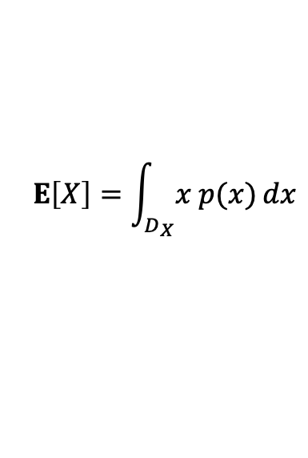
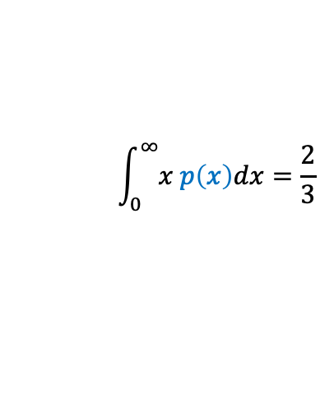
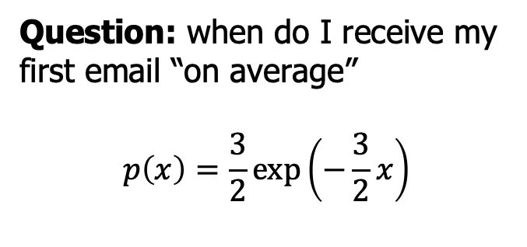
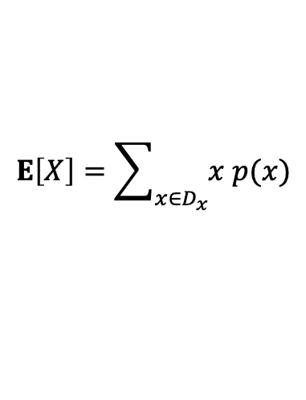
Expected (Mean) Values
If $D_{X}⊆ℝ$, we define expected value $E[X]$ of $X$ as:
$$E\left[X\right]=\int_{D_{X}}{x p(x)}dx$$
$$E\left[X\right]=\sum_{x∈D_{x}}{x p(x)}$$
continuous X
discrete X
Question: when do I receive my first email “on average”
$$p\left(x\right)=\frac{3}{2}\exp\left(−\frac{3}{2}x\right)$$
$$\int_{0}^{∞}{x p\left(x\right)dx}=\frac{2}{3}$$
See Activity 0.2 for more details
Probabilistic Machine Learning
Notes:
20

Slide 21
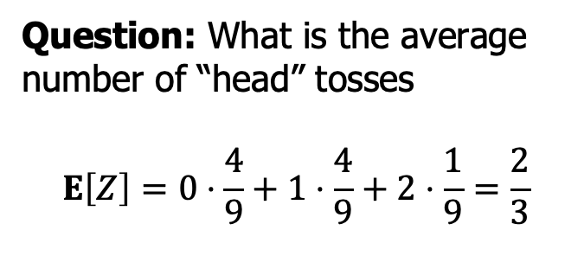
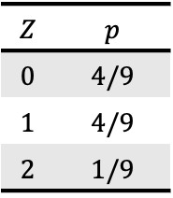
Expected (Mean) Values
If $D_{X}⊆ℝ$, we define expected value $E[X]$ of $X$ as:
$$E\left[X\right]=\int_{D_{X}}{x p(x)}dx$$
$$E\left[X\right]=\sum_{x∈D_{x}}{x p(x)}$$
continuous X
discrete X
Question: What is the average number of “head” tosses
$$E\left[Z\right]=0⋅\frac{4}{9}+1⋅\frac{4}{9}+2⋅\frac{1}{9}=\frac{2}{3}$$
$$Z$$ | $$p$$
$$0$$ | $$4/9$$
$$1$$ | $$4/9$$
$$2$$ | $$1/9$$
Probabilistic Machine Learning
Notes:
21

Slide 22
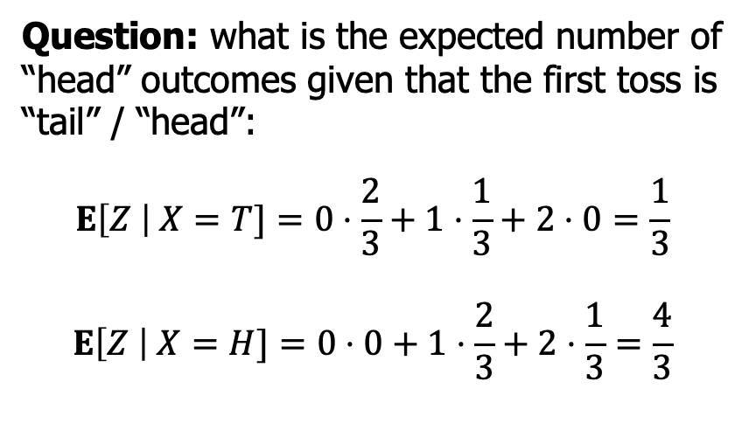
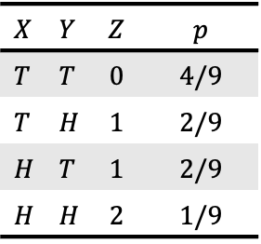
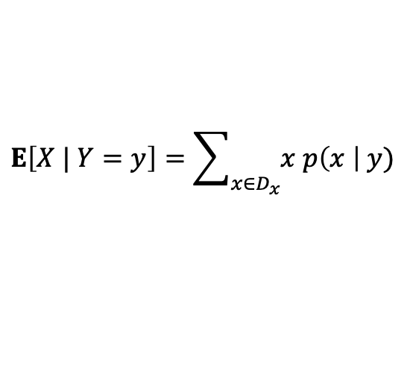
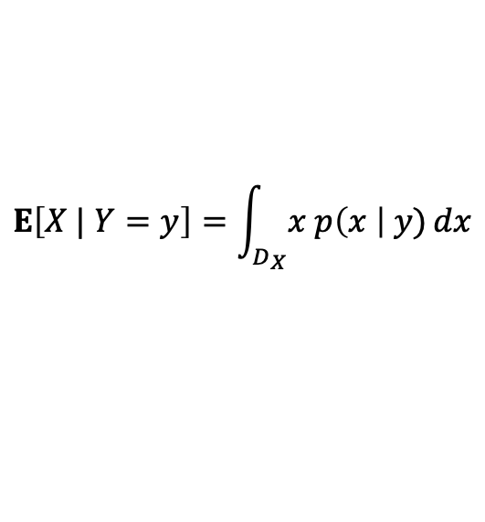
Conditional Expectation
For $y∈D_{Y}$ with $p\left(y\right)>0$, we can also define conditional expectation:
$$E\left[X | Y=y\right]=\int_{D_{X}}{x p\left(x \right| y)}dx$$
$$E\left[X | Y=y\right]=\sum_{x∈D_{x}}{x p\left(x \right| y)}$$
continuous X
discrete X
Question: what is the expected number of “head” outcomes given that the first toss is “tail” / “head”:
$$E\left[Z \right| X=T]=0⋅\frac{2}{3}+1⋅\frac{1}{3}+2⋅0=\frac{1}{3}$$
$$E\left[Z \right| X=H]=0⋅0+1⋅\frac{2}{3}+2⋅\frac{1}{3}=\frac{4}{3}$$
$$X$$ | $$Y$$ | $$Z$$ | $$p$$
$$T$$ | $$T$$ | $$0$$ | $$4/9$$
$$T$$ | $$H$$ | $$1$$ | $$2/9$$
$$H$$ | $$T$$ | $$1$$ | $$2/9$$
$$H$$ | $$H$$ | $$2$$ | $$1/9$$
Probabilistic Machine Learning
Notes:
22

Slide 23
Probabilistic Models: Learning about a coin
Probabilistic Machine Learning
Notes:
We already have a understanding of basic concepts of probability theory. Actually, probability has many other concepts or properties but the above are the ones that we are going to use in measuring the uncertainty in machine learning. To keep consistent with our previous introduction, we still use the example of tossing a coin.
23

Slide 24
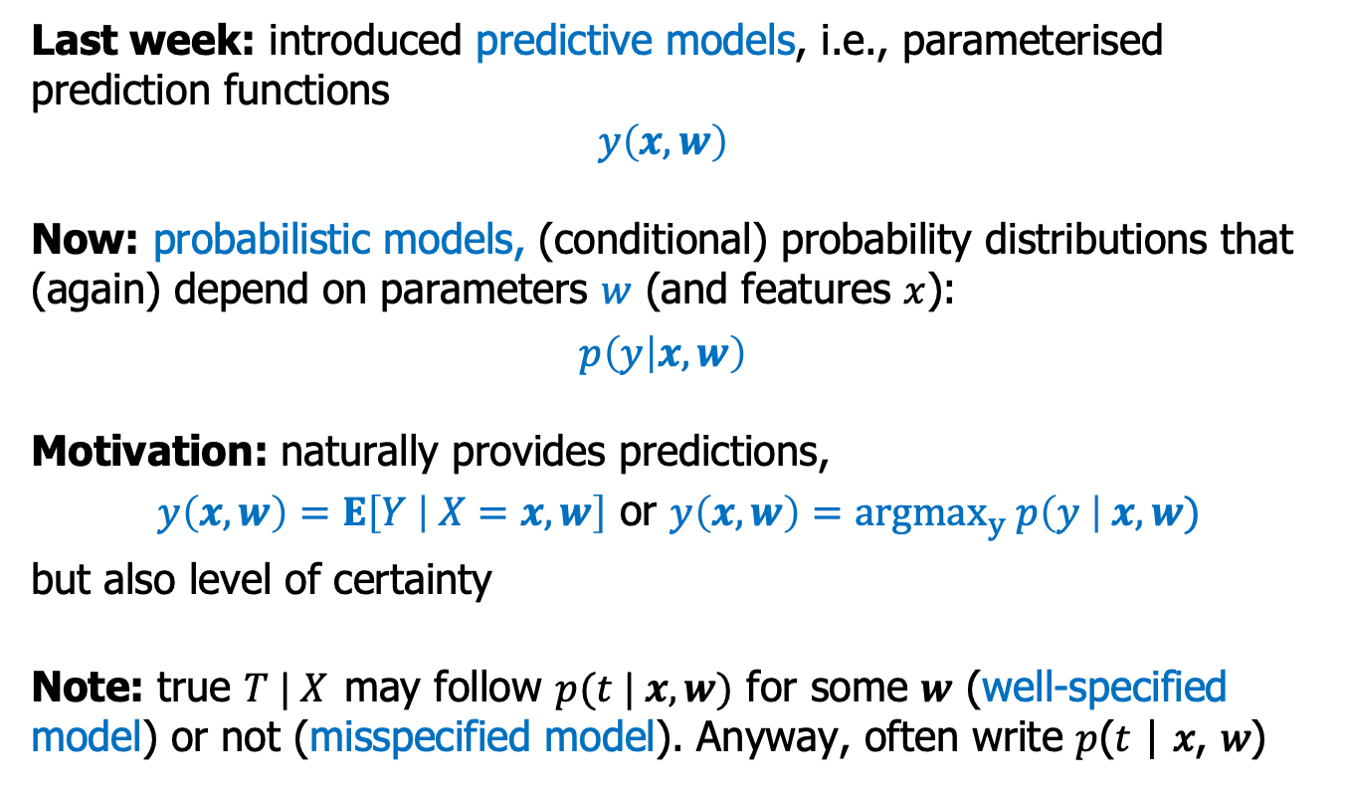
Probabilistic Models
Last week: introduced predictive models, i.e., parameterised prediction functions
$$y\left(x, w\right)$$
Now: probabilistic models, (conditional) probability distributions that (again) depend on parameters $w$ (and features $x$):
$$p\left(y | x, w\right)$$
Motivation: naturally provides predictions,
$y\left(x,w\right)=E\left[Y | X=x,w\right]$ or $y\left(x,w\right)={argmax}_{y} p\left(y \right| x, w)$
but also level of certainty
Note: true $T | X$ may follow $p(t | x, w)$ for some $w$ (well-specified model) or not (misspecified model). Anyway, often write 𝑝(𝑡 | 𝑥, 𝑤)
Probabilistic Machine Learning
Notes:
Notice the coin might be damaged, so we cannot make the assumption that the head and tail would be half and half. Here we want to build a model for this coin tossing.
24

Slide 25
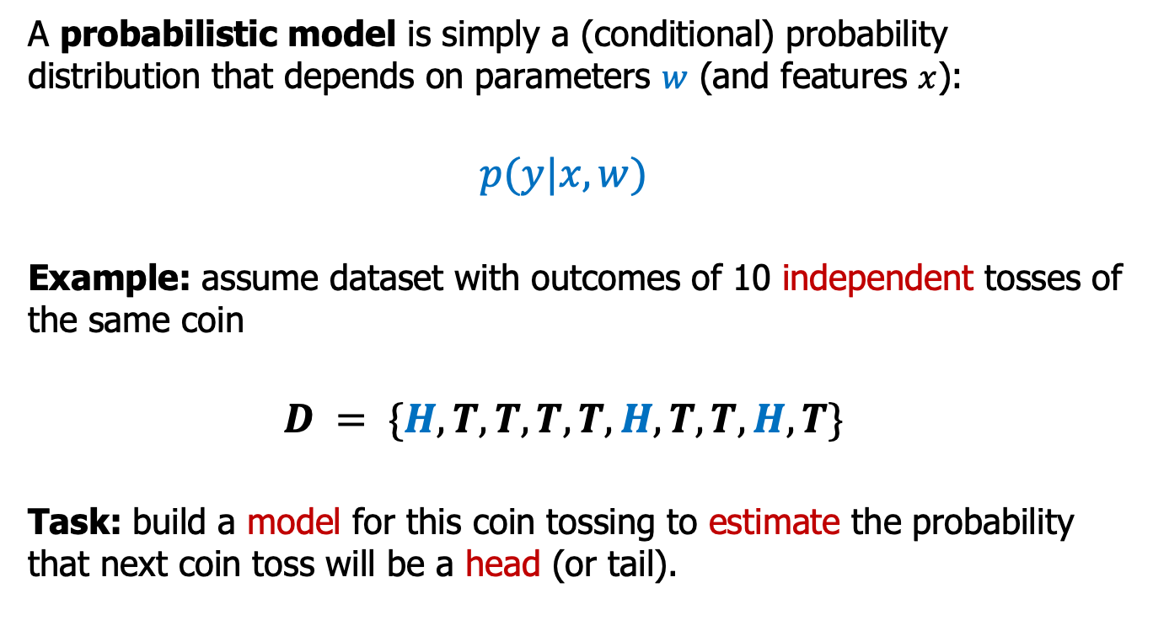
Probabilistic Models
A probabilistic model is simply a (conditional) probability distribution that depends on parameters $w$ (and features $x$):
$$p(y|x, w)$$
Example: assume dataset with outcomes of 10 independent tosses of the same coin
$$D = \{H, T, T, T, T, H, T, T, H, T\}$$
Task: build a model for this coin tossing to estimate the probability that next coin toss will be a head (or tail).
Probabilistic Machine Learning
Notes:
Notice the coin might be damaged, so we cannot make the assumption that the head and tail would be half and half. Here we want to build a model for this coin tossing.
25

Slide 26
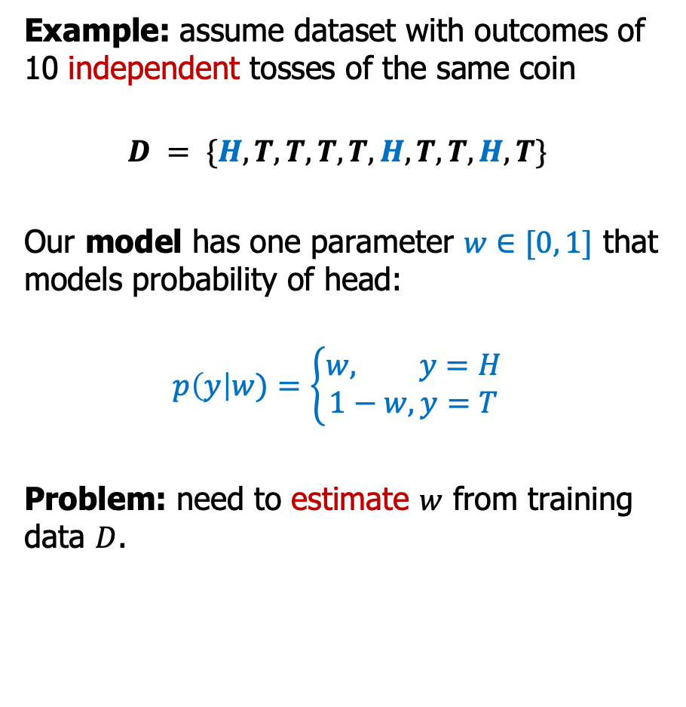
Learning about a coin
Example: assume dataset with outcomes of 10 independent tosses of the same coin
$$D = \{H, T, T, T, T, H, T, T, H, T\}$$
Our model has one parameter $w∈[0, 1]$ that models probability of head:
$$p\left(y\right|w)=\left\{\begin{aligned}w, y=H \\ 1−w, y=T\end{aligned}\right.$$
Problem: need to estimate $w$ from training data $D$.
Probabilistic Machine Learning
Notes:
Notice the coin might be damaged, so we cannot make the assumption that the head and tail would be half and half. Here we want to build a model for this coin tossing.
26

Slide 27
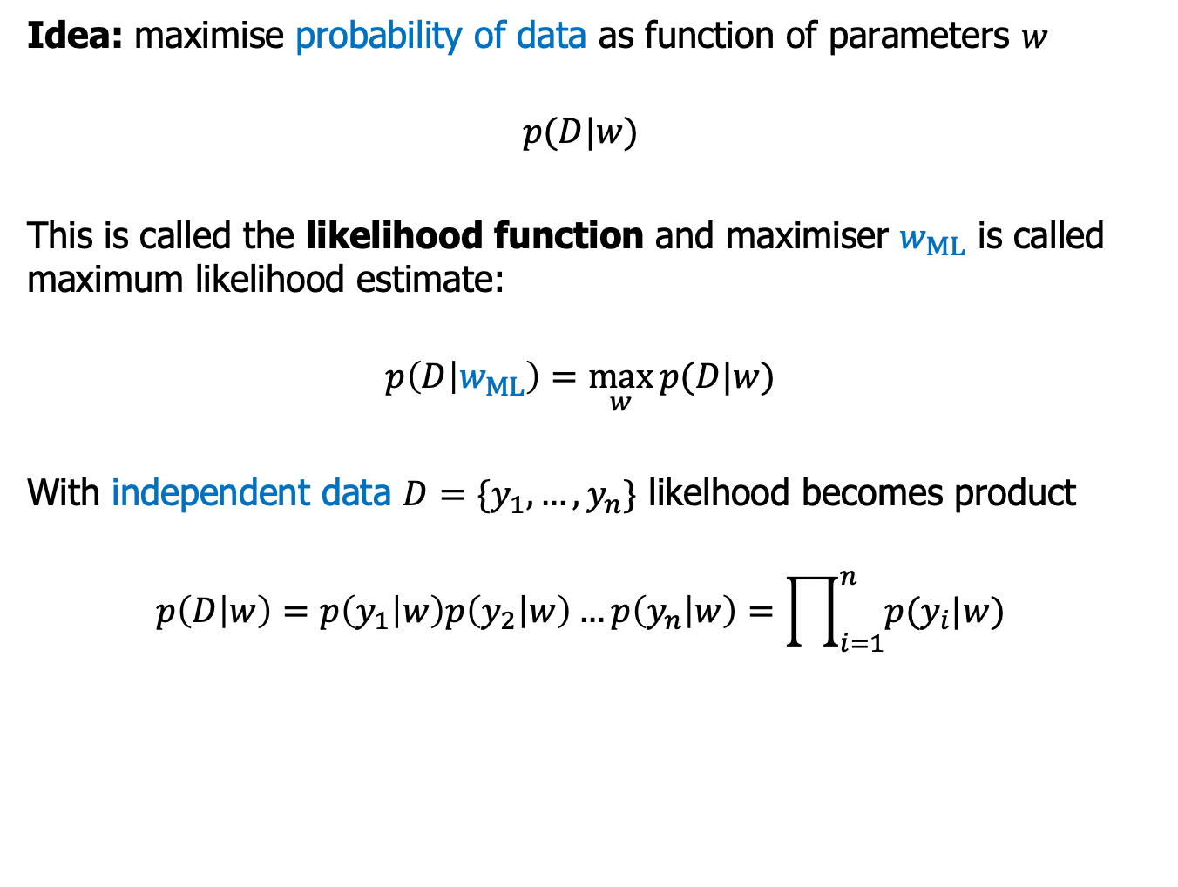
Maximum Likelihood Principle
Idea: maximise probability of data as function of parameters $w$
$$p(D|w)$$
This is called the likelihood function and maximiser $w_{ML}$ is called maximum likelihood estimate:
$$p\left(D | w_{ML}\right)=\max_{w}{p(D|w)}$$
With independent data $D=\{y_{1},…,y_{n}\}$ likelhood becomes product
$$p\left(D | w\right)=p\left(y_{1} | w\right)p\left(y_{2} | w\right)…p\left(y_{n} | w\right)=\prod_{i=1}^{n}{p(y_{i}|w)}$$

Slide 28
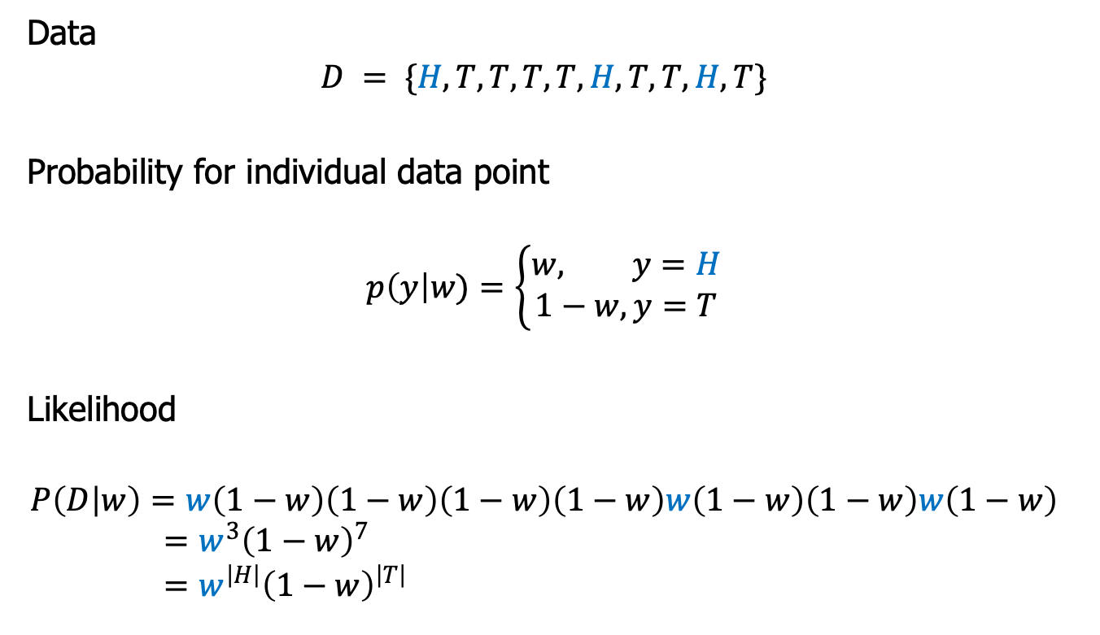
Likelihood Function for Coin Example
Data
$$D = \{H, T, T, T, T, H, T, T, H, T\}$$
Probability for individual data point
$$p\left(y\right|w)=\left\{\begin{aligned}w, y=H \\ 1−w, y=T\end{aligned}\right.$$
Likelihood
$$P\left(D | w\right)=w\left(1−w\right)\left(1−w\right)\left(1−w\right)\left(1−w\right)w\left(1−w\right)\left(1−w\right)w\left(1−w\right) \\ =w^{3}{\left(1−w\right)}^{7} \\ =w^{\left|H\right|}{\left(1−w\right)}^{\left|T\right|}$$

Slide 29
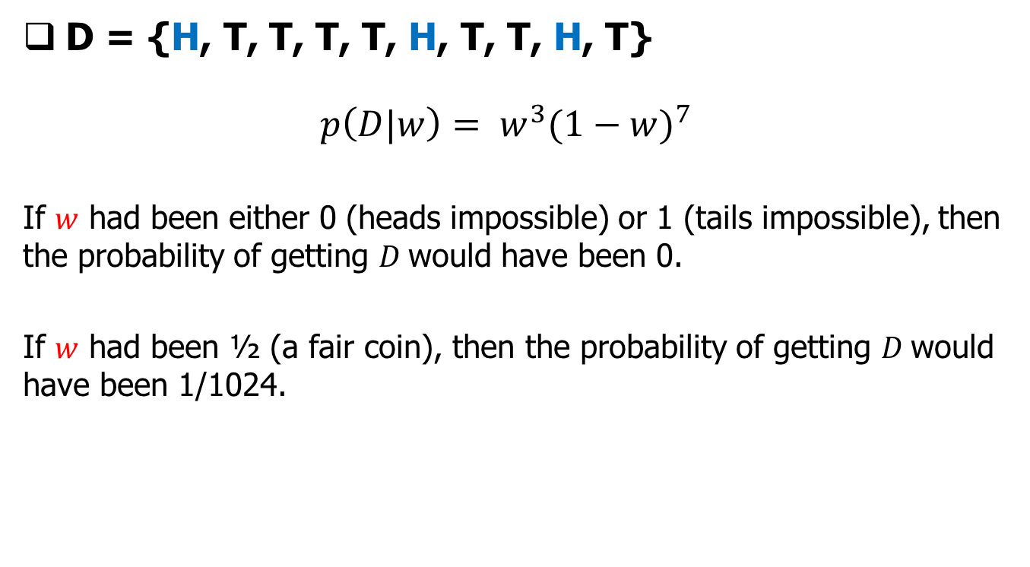
Maximum Likelihood
Probabilistic Machine Learning
Notes:
Any intuitions about how to maximize this?
29

Slide 30
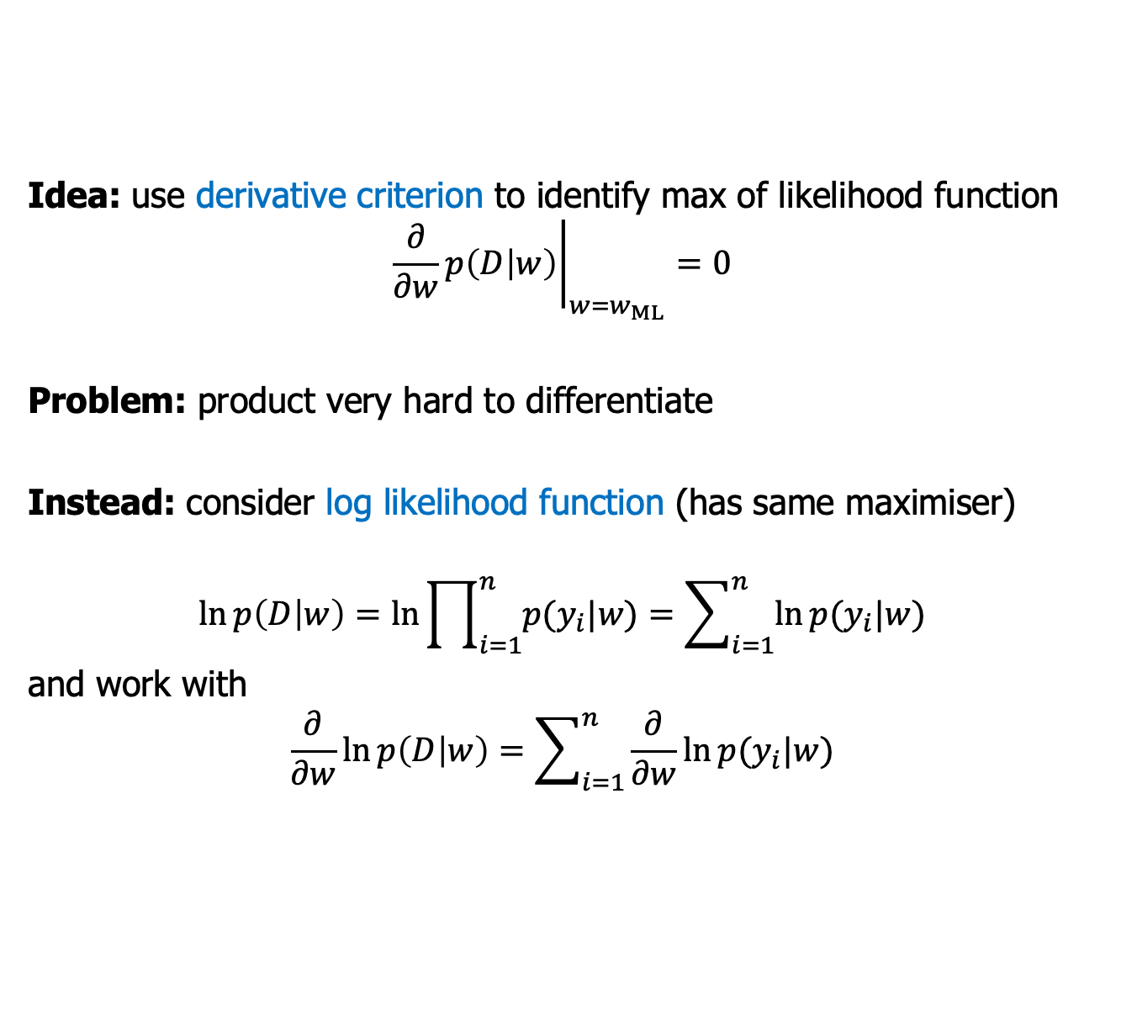
Find Maximum Likelihood Estimate
Idea: use derivative criterion to identify max of likelihood function
$${\left.\frac{∂}{∂w}p\left(D | w\right)\right|}_{w=w_{ML}}=0$$
Problem: product very hard to differentiate
Instead: consider log likelihood function (has same maximiser)
$$\ln{p\left(D | w\right)=\ln{\prod_{i=1}^{n}{p(y_{i}|w)}}}=\sum_{i=1}^{n}{\ln{p(y_{i}|w)}}$$
and work with
$$\frac{∂}{∂w}\ln{p\left(D | w\right)}=\sum_{i=1}^{n}{\frac{∂}{∂w}\ln{p(y_{i}|w)}}$$

Slide 31
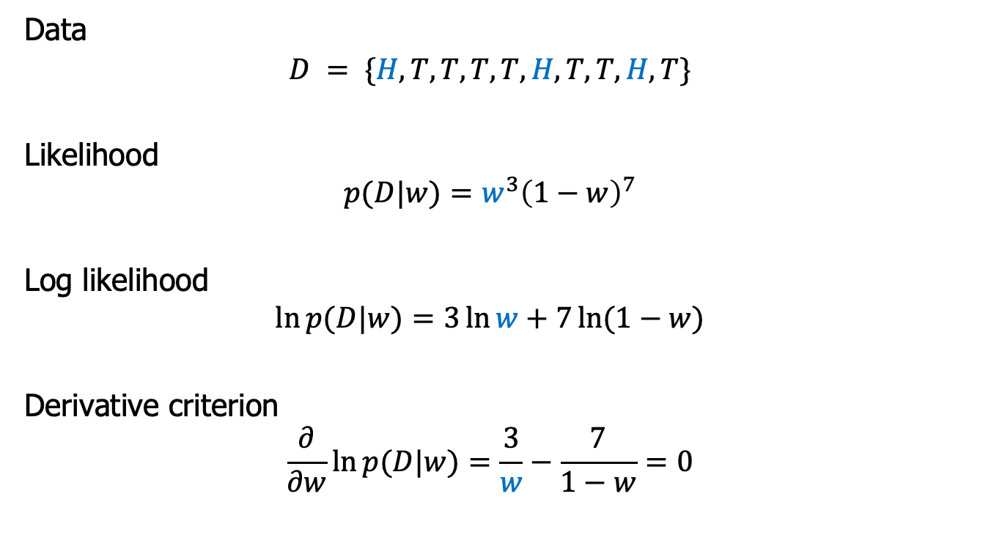

MLE for Coin Example
Data
$$D = \{H, T, T, T, T, H, T, T, H, T\}$$
Likelihood
$$p(D|w)=w^{3}{\left(1−w\right)}^{7}$$
Log likelihood
$$\ln{p(D|w)}=3\ln{w}+7\ln{(1−w)}$$
Derivative criterion
$$\frac{∂}{∂w}\ln{p(D|w)}=\frac{3}{w}−\frac{7}{1−w}=0$$
Result: $w_{ML}=0.3$

Slide 32
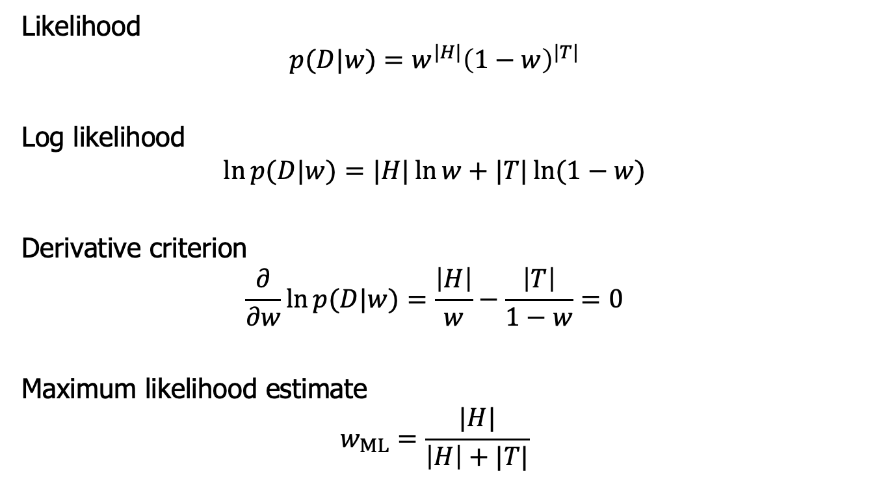
MLE for Coin Example in General
Likelihood
$$p(D|w)=w^{|H|}{\left(1−w\right)}^{|T|}$$
Log likelihood
$$\ln{p(D|w)}=|H|\ln{w}+|T|\ln{(1−w)}$$
Derivative criterion
$$\frac{∂}{∂w}\ln{p(D|w)}=\frac{\left|H\right|}{w}−\frac{\left|T\right|}{1−w}=0$$
Maximum likelihood estimate
$$w_{ML}=\frac{|H|}{\left|H\right|+|T|}$$

Slide 33
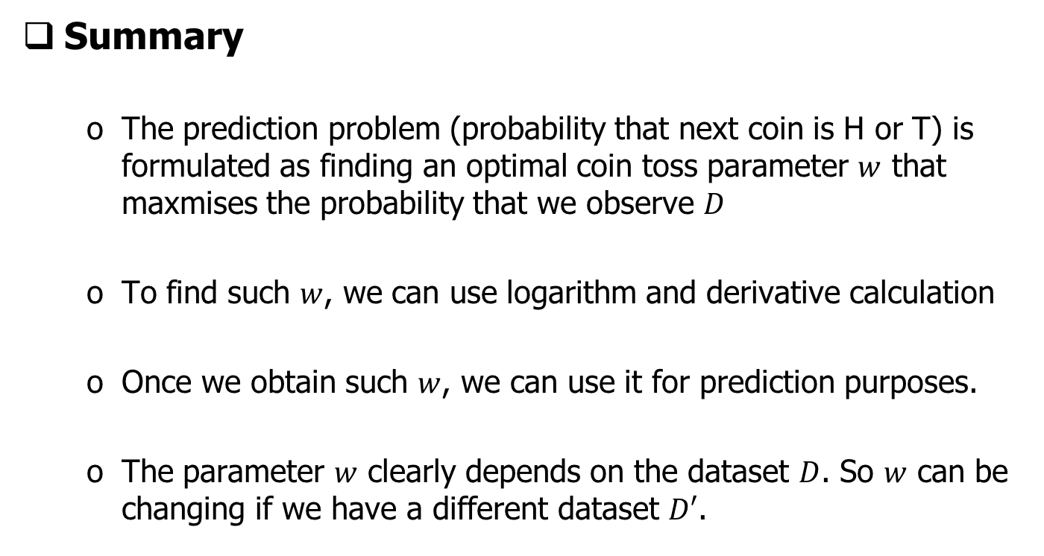
Learning about a coin
Probabilistic Machine Learning
Notes:
Here is the summary of the major points introduced in previous slides.
Let’s assume that if we change one tail to head, the prediction of coming head will be 0.2 instead of 0.3, right? Is this possible? Totally possible, right? If you do this 10 tossing again, even with the same coin, the observed sequence can be different. How can you represent this uncertainty about your prediction?
33

Slide 34
Bootstrap
Probabilistic Machine Learning
Notes:
The solution is bootstapping.
34

Slide 35
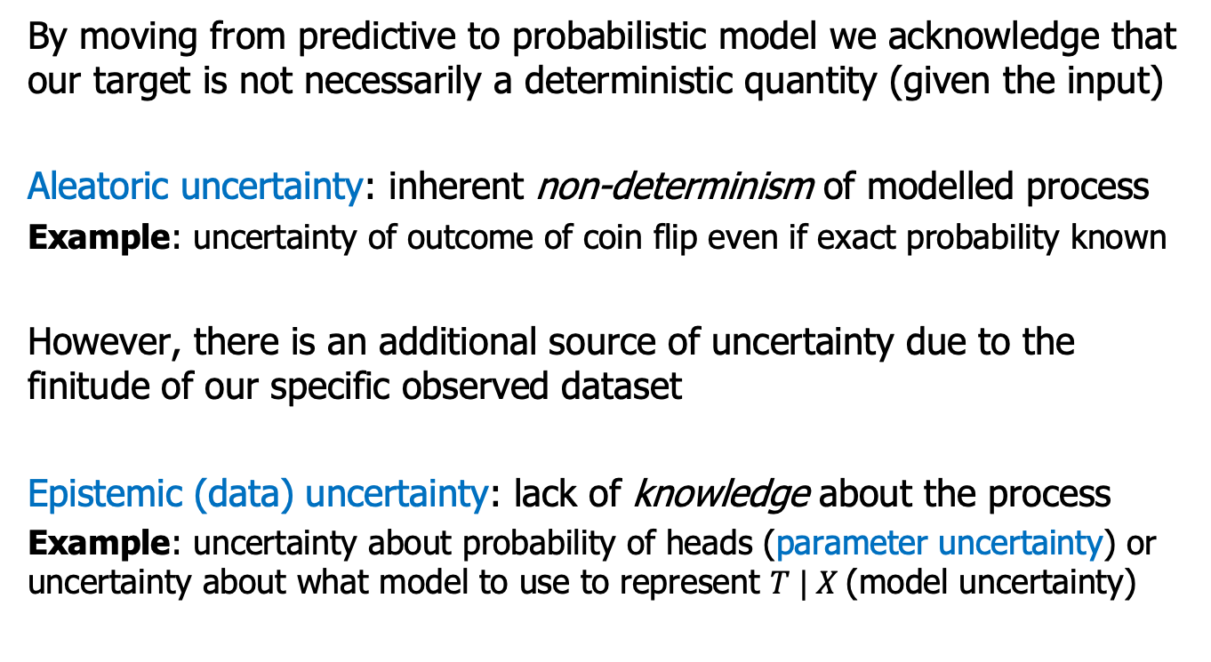
Uncertainty Quantification
By moving from predictive to probabilistic model we acknowledge that our target is not necessarily a deterministic quantity (given the input)
Aleatoric uncertainty: inherent non-determinism of modelled process
Example: uncertainty of outcome of coin flip even if exact probability known
However, there is an additional source of uncertainty due to the finitude of our specific observed dataset
Epistemic (data) uncertainty: lack of knowledge about the process
Example: uncertainty about probability of heads (parameter uncertainty) or uncertainty about what model to use to represent $T | X$(model uncertainty)
Probabilistic Machine Learning
Notes:
We wonder our estimated parameter would change if we have an alternate dataset 𝐷′
If we do this exercise for several alternate datasets, then we will have a distribution over estimates for 𝒘 .
The higher the variance of this distribution, the more uncertainty we have about our parameter estimates.
Now, the problem is how to get the alternate datasets? We know that we are given only one initial dataset, and in most cases, we are not allowed to request more datasets. Any ideas? How to get more datasets.
35

Slide 36
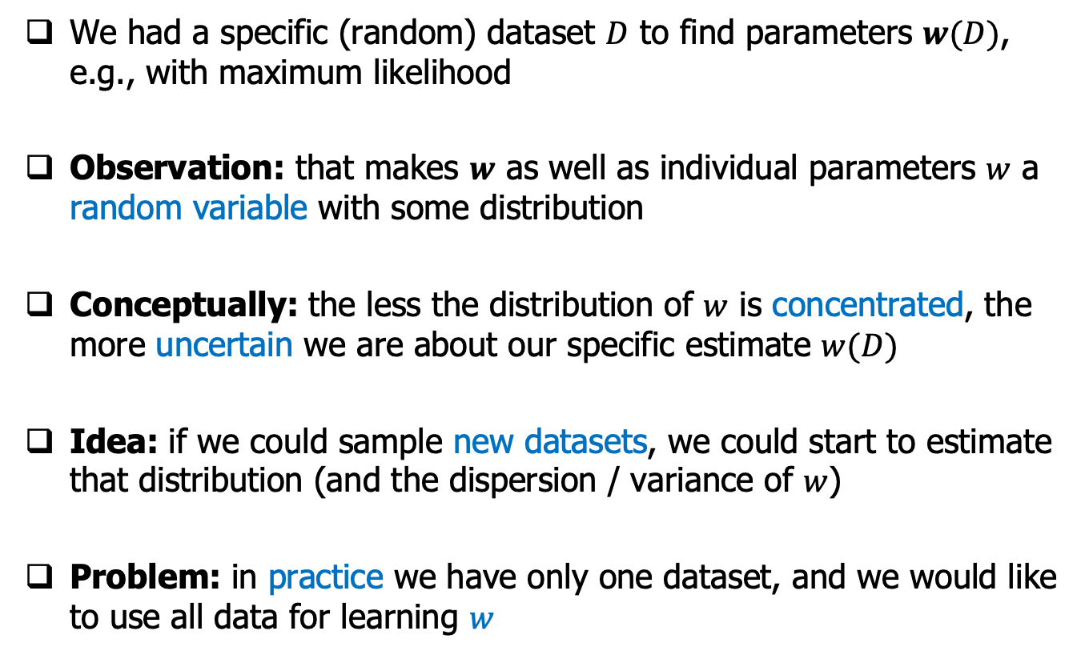
Parameter Uncertainty Conceptually
We had a specific (random) dataset $D$ to find parameters $w(D)$, e.g., with maximum likelihood
Observation: that makes $w$ as well as individual parameters $w$ a random variable with some distribution
Conceptually: the less the distribution of $w$ is concentrated, the more uncertain we are about our specific estimate $w(D)$
Idea: if we could sample new datasets, we could start to estimate that distribution (and the dispersion / variance of $w$)
Problem: in practice we have only one dataset, and we would like to use all data for learning $w$

Slide 37
Bootstrap for Quantifying Uncertainty
Now, the problem is how to get the alternate datasets?
clue: generate the alternate datasets from the original dataset. But how?
Solution: resampling with bootstrap strategy
Basic idea of bootstrap: approximate the real distribution in the infinity situation with the empirical distribution
Probabilistic Machine Learning
Notes:
We wonder our estimated parameter would change if we have an alternate dataset 𝐷′
If we do this exercise for several alternate datasets, then we will have a distribution over estimates for 𝒘 .
The higher the variance of this distribution, the more uncertainty we have about our parameter estimates.
Now, the problem is how to get the alternate datasets? We know that we are given only one initial dataset, and in most cases, we are not allowed to request more datasets. Any ideas? How to get more datasets.
Bootstrap: proposed by statisticians, has been proven theoretically. I will not go through the theoretical details of Bootstrap here, because we are computer science guy, right? What you need to know is that it has been widely used in machine learning as a scheme quantifying the uncertainty.
37

Slide 38
Bootstrap Example
A bootstrap sample is a random sample conducted with replacement
Randomly select an observation from the original data
Write it down
Put it back (i.e. Any observation can be selected more than once)
Repeat these steps 1-3 N times; N is the number of observations in the original sample
Final Result: One “bootstrap sample” with N observations
N
0
0
0
48
24
37
3
5
0
37
1
Target
Age
Inquires
1
0
48
3
0
37
1
0
37
1
…
Original Data
0
24
5
Notes:
38

Slide 39
Summary
Classical or frequentist interpretation of uncertainty
View probabilities in terms of the frequencies of random, repeatable events, in the limit of infinity.
Use bootstrap sample strategy to simulate infinity based on the available data.
Learn the model by maximizing the likelihood of every single bootstrap data set.
Evaluate the uncertainty by looking at the variability of predictions between the different bootstrap data sets.
Probabilistic Machine Learning
Notes:
39

Slide 40
Probabilistic Machine Learning
Bayesian Approach to
Machine Learning
(use probabilities to quantify the uncertainty directly)
Notes:
40

Slide 41
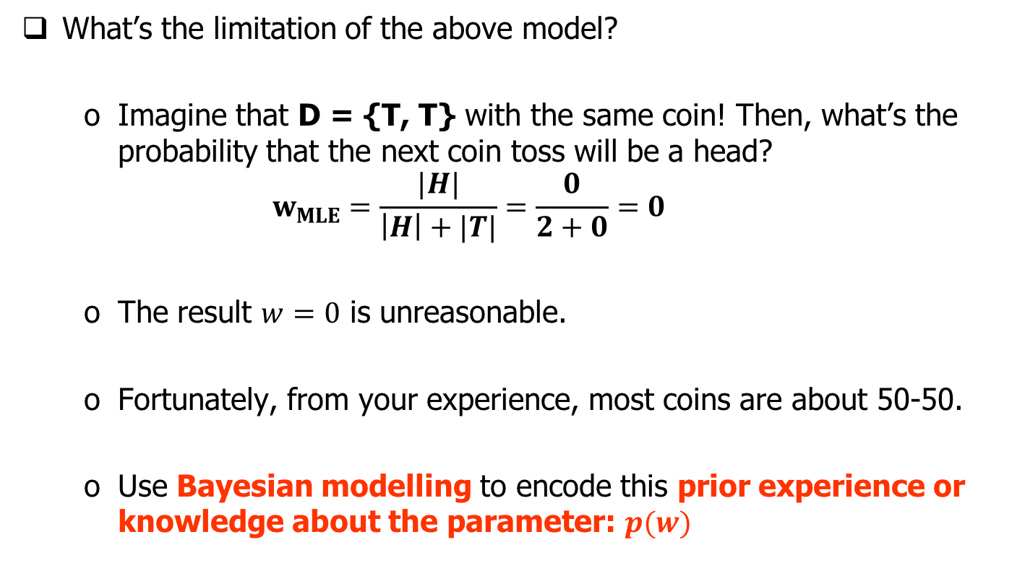
Motivation for Bayesian Approach
Probabilistic Machine Learning
Notes:
For this example, even with the bootstrap strategy, the resampled datasets would still contain the tail only. No head. Based on the previous method, our estimation of becoming head would be 0 for sure.
But we are humans and we know from our experience that most coins should be about 50-50. So if this coin is fair, so any idea about the problem of this data set? Why we get a such wrong answer? Yes, the size of the datasets. Our prior experience is like encoding the knowledge of distributions in infinity, as you know we human know most coins are fair and if they are fair, if you toss it for infinite times, you have a large probability to have a 50% getting a head.
So one important characteristic of Bayesian approach is with it, you can encode this prior experience or knowledge about the parameter into the model. About how, I will introduce in details in the later slides.
41

Slide 42
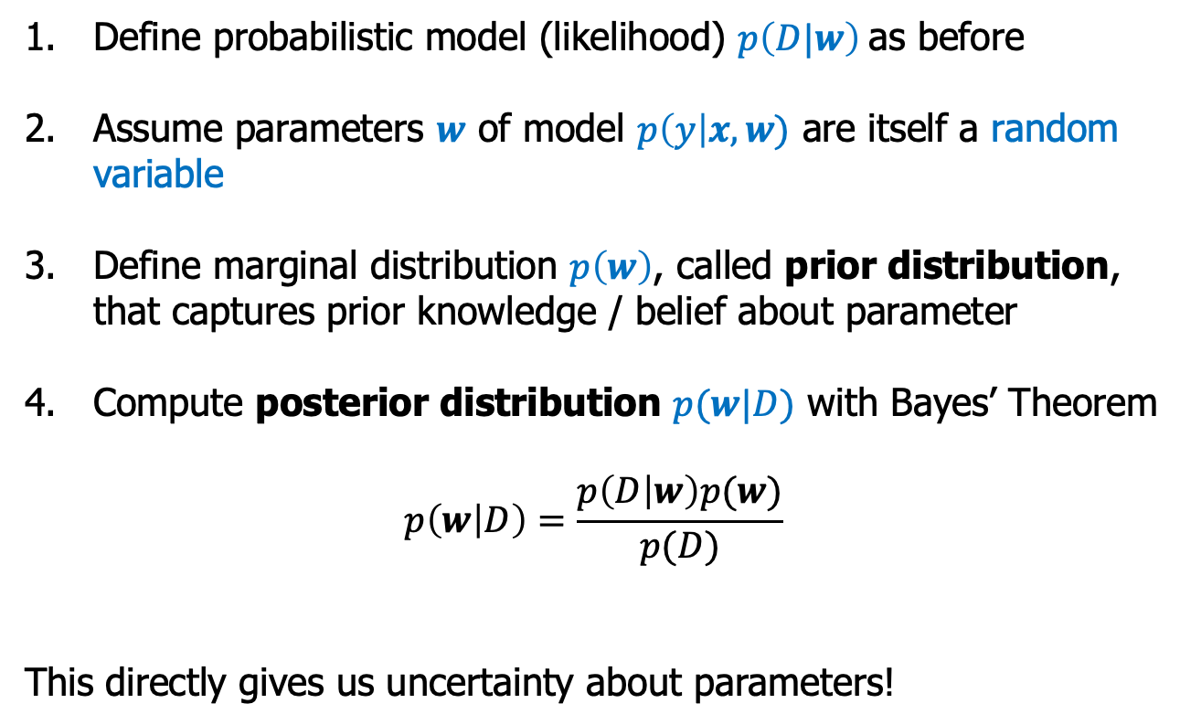
What is Bayesian Approach to ML
Define probabilistic model (likelihood) $p\left(D|w\right)$as before
Assume parameters $w$ of model $p\left(y\right|x, w)$ are itself a random variable
Define marginal distribution $p\left(w\right)$, called prior distribution, that captures prior knowledge / belief about parameter
Compute posterior distribution $p(w|D)$ with Bayes’ Theorem
$$p\left(w | D\right)=\frac{p\left(D | w\right)p(w)}{p(D)}$$
This directly gives us uncertainty about parameters!
posterior
likelihood
prior
Probabilistic Machine Learning
Notes:
42

Slide 43
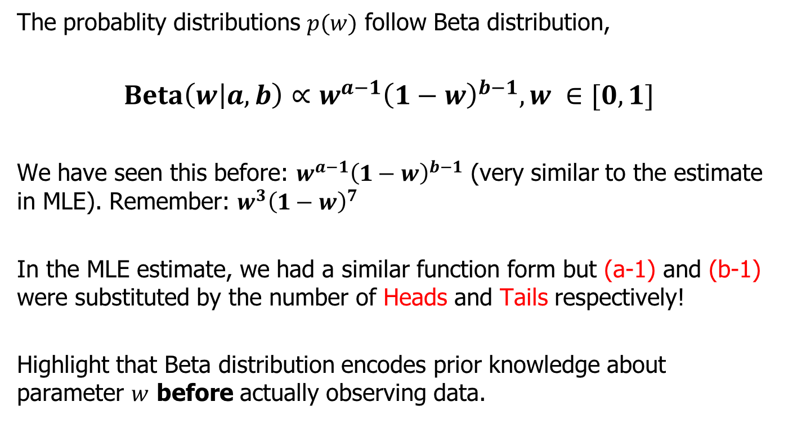
Encoding Prior Knowledge
Probabilistic Machine Learning
Notes:
Conjugate prior
43

Slide 44



Encoding Prior Knowledge
2+3-2= 3 tosses
2-1=1 (H)
3-1=2 (T)
4th toss H? 1/3
w
w
Notes:
In other words: Beta distribution with parameters a and b, which basically pretends that we’ve previously seen a-1 heads and b-1 tails, respectively, before we perform coin tossing.
C
Looking at different beta dist. If we set a =1, b=1, we see uniform dist. Which means I don’t know anything about parameter or this coin.
Prior knowledge is represented as probabilty distribution over parameter w......which means we can now estimate the uncertainty of the parameter using probabilty distribution over 𝒘
<end>
So effectively, now we have more data from which to perform estimate for parameter w.
Once we’ve specified this prior belief, we can now come up with an estimate for our model’s parameter given both our prior belief and the newly observed data.
44

Slide 45

What is Bayesian Approach to ML
Probabilistic Machine Learning
Notes:
45

Slide 46

What is Bayesian Approach to ML
Probabilistic Machine Learning
Notes:
46

Slide 47

Bayesian Approach: Prediction
Probabilistic Machine Learning
Notes:
47

Slide 48

Bayesian Approach: Prediction
Probability of head given data
$$p\left(H | D\right)=\int_{0}^{1}{p\left(H,w | D\right)dw} \\ =\int_{0}^{1}{p\left(H | w,D\right)p\left(w | D\right)dw} \\ =\int_{0}^{1}{w p\left(w | D\right)dw} \\ =E\left[w\right|D] \\ =\frac{\left|H\right|+a}{\left|H\right|+\left|T\right|+a+b}$$
sum rule
chain rule
def of model
def of expectation
from Beta distribution

Slide 49

Bayesian Approach: Prediction
Probabilistic Machine Learning
Notes:
49

Slide 50

Summary 1/3: Probability
Random variables $X$ take on values $x$ from some domain $D_{X}$
Probability distributions of $X$ given by mass or density functions $p$
Probabilities (masses) lie in $[0,1]$and sum to one $\sum_{x∈D_{x}}{p\left(x\right)}=1$
Densities integrate to one $\int_{−∞}^{∞}{p\left(x\right)dx}=1$
Conditional probability $p\left(y | x\right)$
Joint probability / product rule $p\left(x,y\right)=p\left(y | x\right)p\left(x\right)$
Marginal probability $p\left(x\right)=\sum_{x∈D_{x}}{p\left(x,y\right)}$ or $p\left(x\right)=\int_{D_{x}}{p\left(x,y\right)dx}$
Bayes’ theorem $p\left(x | y\right)=p\left(y | x\right)p\left(x\right)/p\left(y\right)$
Expected value $E[X]$ (if $D_{X}⊆ℝ$) $\sum_{x∈D_{x}}{x p\left(x\right)}$ or $\int_{D_{X}}{x p\left(x\right)dx}$
Conditional expectations $E\left[Y | X=x\right]=\int_{D_{Y}}{y p\left(x,y\right)dy}$
Probabilistic Machine Learning

Slide 51

Summary 2/3: Uncertainty
Probabilistic models describe conditional distribution of target variable given input variables (and parameters) and thus describe aleatoric uncertainty of modelled process
Maximum Likelihood Estimation (MLE): choose parameter values to maximise (modelled) probability of observed data
Typically done by minimising the negative log likelihood
Epistemic uncertainty about parameters and predictions due to finite data, i.e., could have observed different $X$ and also different $Y$ given $X$ (noise)
Probabilistic Machine Learning

Slide 52
Summary 3/3: Quantifying Uncertainty
Bootstrap quantifies epistemic uncertainty by re-fitting model with datasets re-sampled from available data
Results in distribution over parameters, predictions, and performance estimates
Bayesian models instead define directly prior probability distributions on parameters
Results in posterior distribution (given the data) of parameters and predictions that also quantifies epistemic uncertainty (use Bayes’ theorem to evaluate posterior)
Probabilistic Machine Learning

Slide 53

Notes:
53

